Slide 1
Intel® Smart Connect Technology Remote Wake with WakeMyPC
November 2013 – Revision 1.2
CDI/IBP #: 514349

Slide 2
Disclaimer
INFORMATION IN THIS DOCUMENT IS PROVIDED IN CONNECTION WITH INTEL PRODUCTS. NO LICENSE, EXPRESS OR IMPLIED, BY ESTOPPEL OR OTHERWISE, TO ANY INTELLECTUAL PROPERTY RIGHTS IS GRANTED BY THIS DOCUMENT. EXCEPT AS PROVIDED IN INTEL'S TERMS AND CONDITIONS OF SALE FOR SUCH PRODUCTS, INTEL ASSUMES NO LIABILITY WHATSOEVER AND INTEL DISCLAIMS ANY EXPRESS OR IMPLIED WARRANTY, RELATING TO SALE AND/OR USE OF INTEL PRODUCTS INCLUDING LIABILITY OR WARRANTIES RELATING TO FITNESS FOR A PARTICULAR PURPOSE, MERCHANTABILITY, OR INFRINGEMENT OF ANY PATENT, COPYRIGHT OR OTHER INTELLECTUAL PROPERTY RIGHT.
A "Mission Critical Application" is any application in which failure of the Intel Product could result, directly or indirectly, in personal injury or death. SHOULD YOU PURCHASE OR USE INTEL'S PRODUCTS FOR ANY SUCH MISSION CRITICAL APPLICATION, YOU SHALL INDEMNIFY AND HOLD INTEL AND ITS SUBSIDIARIES, SUBCONTRACTORS AND AFFILIATES, AND THE DIRECTORS, OFFICERS, AND EMPLOYEES OF EACH, HARMLESS AGAINST ALL CLAIMS COSTS, DAMAGES, AND EXPENSES AND REASONABLE ATTORNEYS' FEES ARISING OUT OF, DIRECTLY OR INDIRECTLY, ANY CLAIM OF PRODUCT LIABILITY, PERSONAL INJURY, OR DEATH ARISING IN ANY WAY OUT OF SUCH MISSION CRITICAL APPLICATION, WHETHER OR NOT INTEL OR ITS SUBCONTRACTOR WAS NEGLIGENT IN THE DESIGN, MANUFACTURE, OR WARNING OF THE INTEL PRODUCT OR ANY OF ITS PARTS.
Intel may make changes to specifications and product descriptions at any time, without notice. Designers must not rely on the absence or characteristics of any features or instructions marked "reserved" or "undefined". Intel reserves these for future definition and shall have no responsibility whatsoever for conflicts or incompatibilities arising from future changes to them. The information here is subject to change without notice. Do not finalize a design with this information.
The products described in this document may contain design defects or errors known as errata which may cause the product to deviate from published specifications. Current characterized errata are available on request.
Contact your local Intel sales office or your distributor to obtain the latest specifications and before placing your product order.
Copies of documents which have an order number and are referenced in this document, or other Intel literature, may be obtained by calling 1-800-548-4725, or go to: http://www.intel.com/design/literature.htm.
Code names featured are used internally within Intel to identify products that are in development and not yet publicly announced for release. Customers, licensees and other third parties are not authorized by Intel to use code names in advertising, promotion or marketing of any product or services and any such use of Intel's internal code names is at the sole risk of the user.
Intel and the Intel logo are trademarks of Intel Corporation in the U.S. and other countries.
*Other names and brands may be claimed as the property of others.
Copyright © 2013, Intel Corporation. All rights reserved.

Slide 3
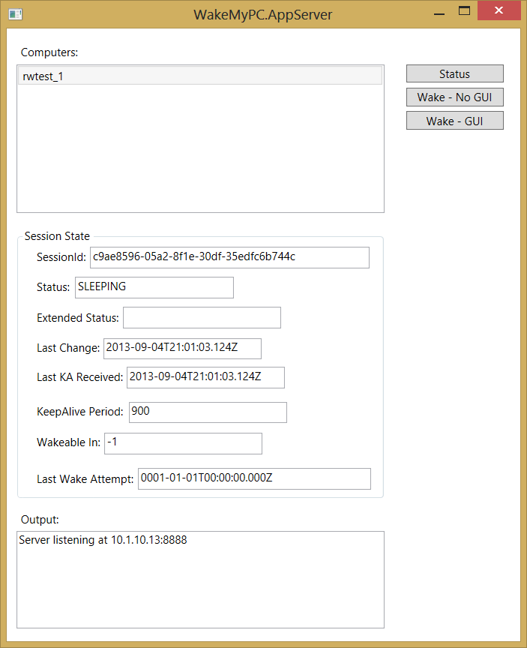
What is WakeMyPC?
WakeMyPC is a client/server application for testing Remote Wake platform enablement
It’s free to use for anyone
Development is ongoing
Server application supports multiple Client platforms

Slide 4
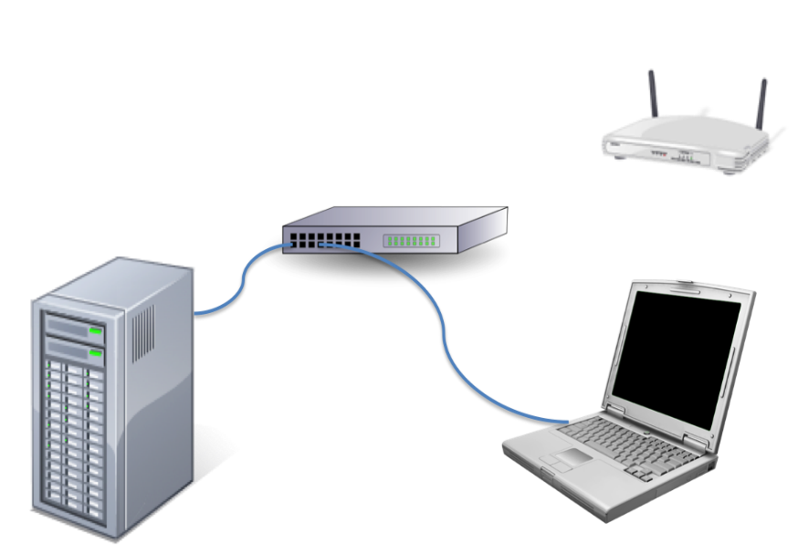
WakeMyPC Requirements
Two platforms:
Server: Windows* 7 SP/Windows* 8 platform (LAN or WLAN)
Remote Wake Client: Windows* 8/Windows* 8.1 platform with Remote Wake Enabled LAN and or WLAN
Windows* Firewall disabled on both platforms
Internet Connection with no proxy server(s)
*Other names and brands may be claimed as the property of others.

Slide 5
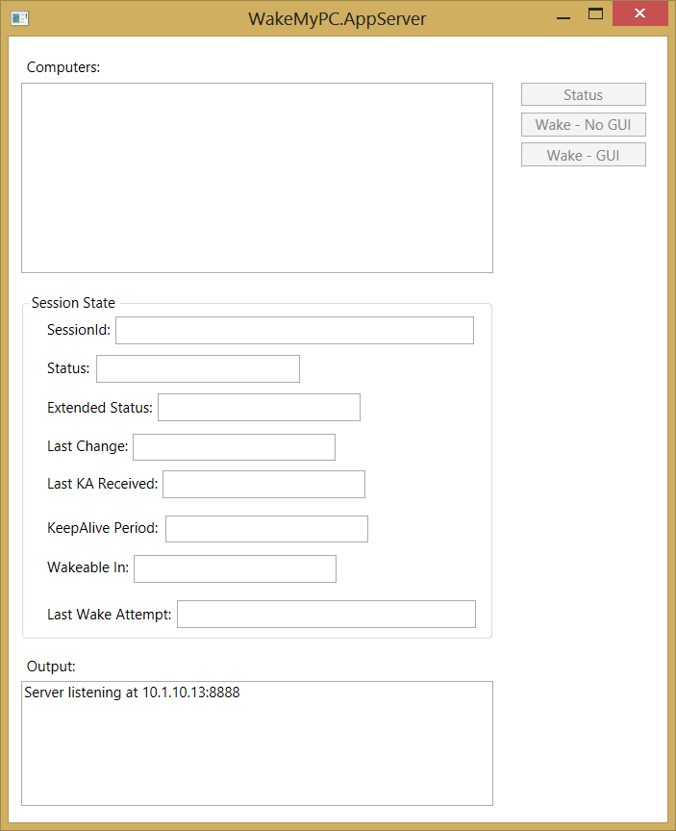
WakeMyPC Server
On the server platform:
Change directory to the WakeMyPC.Appserver
Invoke the application WakeMyPC.AppServer.exe
Application will print in the Output text box the IP address being used (this address as it will be required for the WakeMyPC Client application)

Slide 6
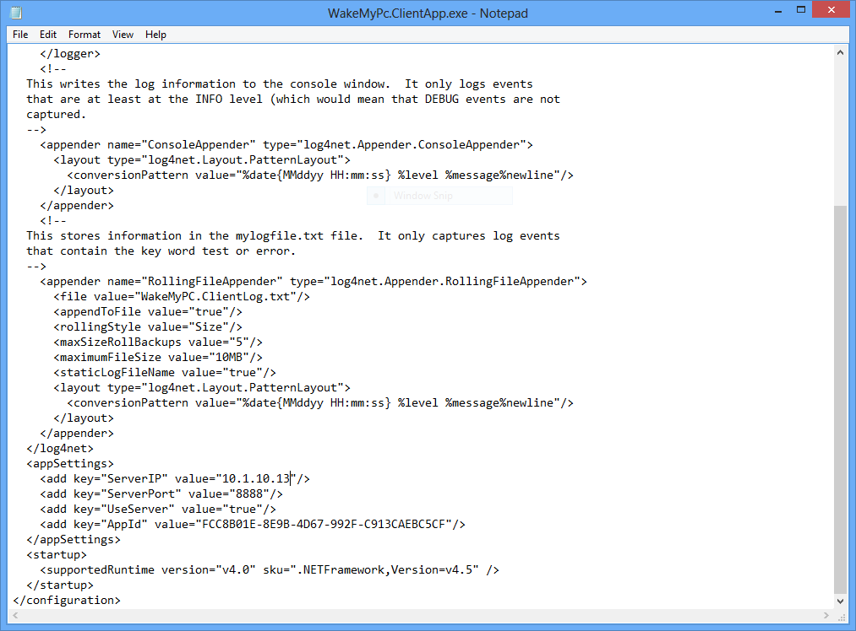
WakeMyPC Client
On the Remote Wake Client Platform:
Change directory to the WakeMyPC.ClientApp
Edit the file: WakeMyPc.ClientApp.exe.config
At the bottom of the file in the “<appSettings>” section, change the value of the “ServerIP” to match the IP Address displayed in the in the server application
Save the file

Slide 7
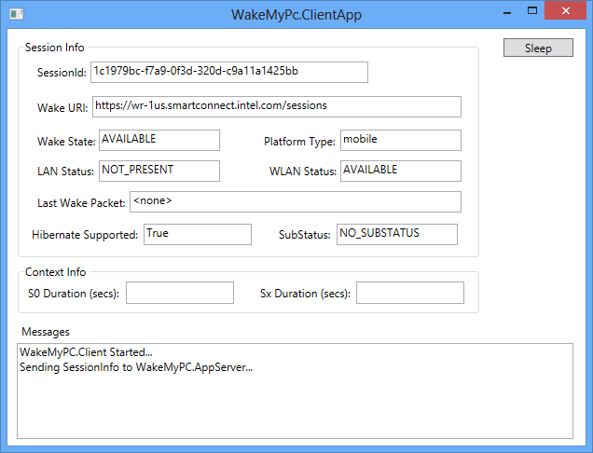
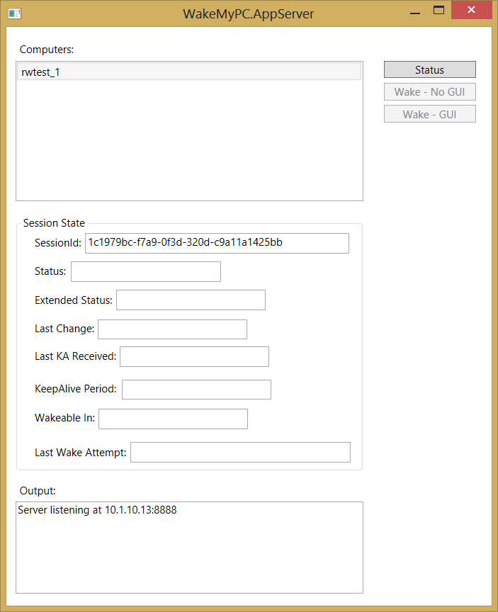
WakeMyPC Client
On the Remote Wake Client Platform:
Change directory to the WakeMyPC.ClientApp
Invoke the file: WakeMyPC.ClientApp.exe
Upon invocation, the application will display the current session information and send this to the WakeMyPC.AppServer.
When the WakeMyPC.AppServer receives the session information, it will display the computer name, SessionId and enable the “Status” button

Slide 8
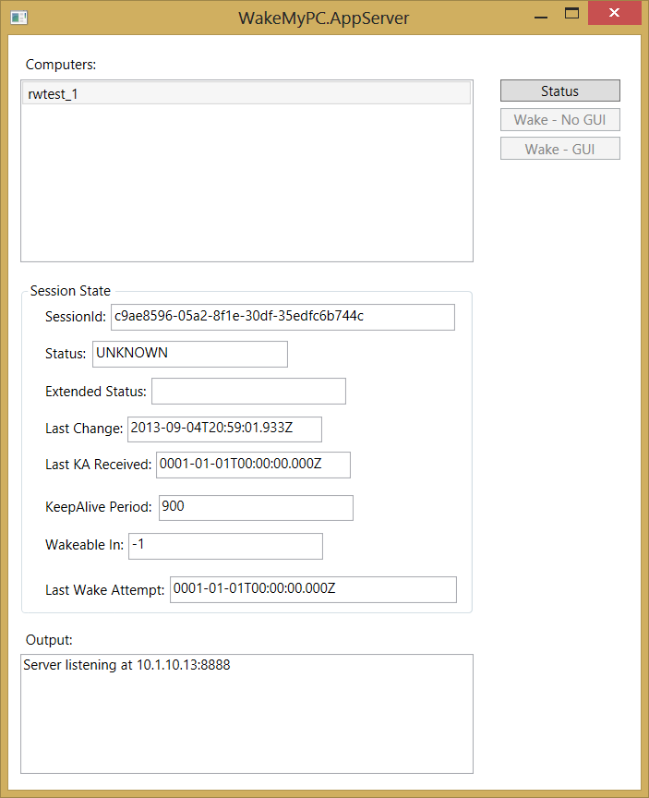
WakeMyPC Server
On the Server Platform:
Click the “Status” button and verify in the Session State information that the Client platform status is “UNKNOWN”. This state indicates that the Client platform is not in the sleeping state

Slide 9
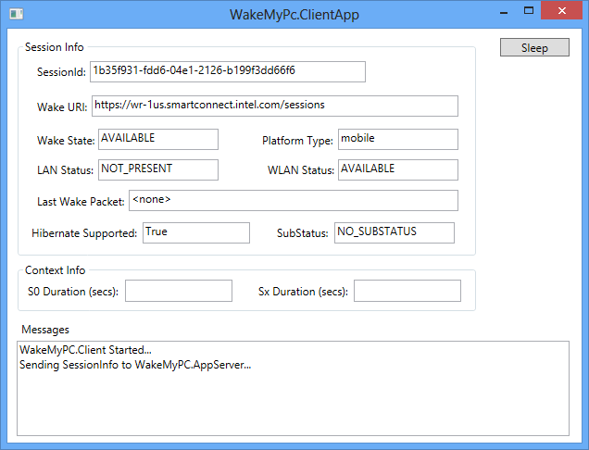
WakeMyPC Client
On the Remote Wake Client Platform:
Click the “Sleep” button to place the platform into S3 sleep state

Slide 10
WakeMyPC Server
On the Server Platform:
Once the Client platform is in the sleep state for several minutes click the “Status” button to check the Status of the Client platform. When the Status field of the Session State reports “SLEEPING”, the two buttons under the Status button will be enabled to wake the platform.
Note: It may take a few minutes for the Client platform and the Intel Wake Server to synchronize the platforms sleep state

Slide 11
WakeMyPC Server
On the Server Platform:
Two wake requests are now available:
Click the “Wake – No GUI” button to send a wake request to the Client platform to have it wake and keep the display off and audio muted
Click the “Wake – GUI” button to send a wake request to the Client platform to have it wake and turn on the display and audio un-muted. When the wake occurs, there will be 3 beeps played

